Slide 1
Agile Methodology
By Falcons

Slide 2
What is Agile Methodology?
Agile methodology is an iterative approach to software and systems development that emphasizes flexibility, collaboration, customer feedback, and rapid delivery of functional components.
It focuses on breaking down large projects into smaller, manageable units called "sprints," which typically last between one to four weeks. Each sprint results in a potentially shippable product increment, which allows for regular adjustments based on feedback.
Agile promotes adaptive planning, evolutionary development, early delivery, and continuous improvement. It encourages cross-functional teams to work together and respond to changes in requirements even late in the development process.

Slide 3
Key Principles Of Agile Methodology:
1.Customer Satisfaction: The primary goal is to satisfy the customer through continuous delivery of valuable software.
2.Embrace Change: Agile welcomes changing requirements, even late in development, to meet evolving business needs.
3.Frequent Delivery: Working software is delivered frequently, with a preference for shorter timescales.
4.Collaboration: Developers work closely with business people throughout the project.

Slide 4
5.Simplicity: The focus is on delivering the simplest solution that meets the requirements.
6.Self-Organizing Teams: Teams have the autonomy to make decisions and are trusted to complete the work.
7.Continuous Feedback and Improvement: Regular reflection on how to become more effective and adjust behavior accordingly.

Slide 5
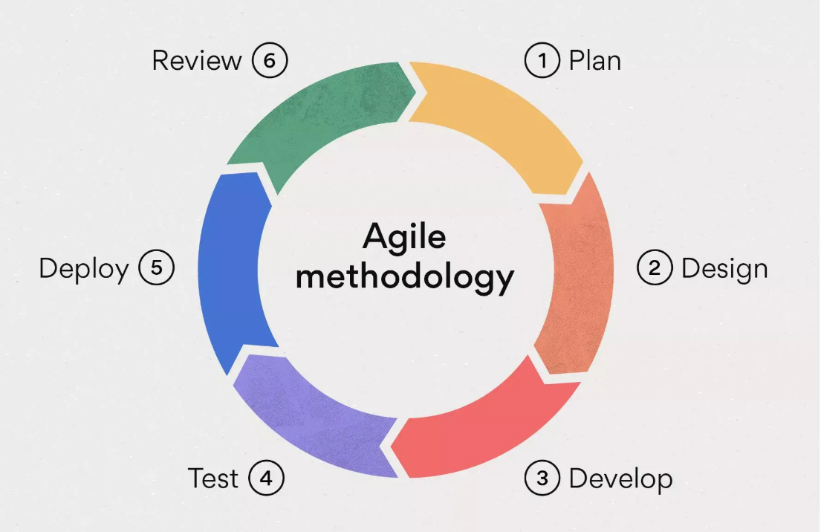

Slide 6
Key Agile Frameworks
1.Scrum: A popular framework that uses sprints, daily stand-ups, sprint reviews, and retrospectives to manage development.
2.Kanban: A visual system that focuses on managing workflow and limiting work in progress.
3.Extreme Programming (XP): Emphasizes technical excellence, frequent releases, and pair programming.

Slide 7
Advantages of Agile Method
Increased Flexibility and Adaptability:
Agile allows for quick adjustments to changing requirements, making it ideal for projects with uncertain or evolving needs.
Improved Customer Satisfaction:
Frequent customer involvement ensures that the product meets their expectations and delivers value.
Faster Time to Market:
Iterative development allows for early and frequent releases of working software, reducing time to market.
Enhanced Collaboration and Communication:
Agile promotes close collaboration and communication among team members, leading to better teamwork and problem-solving.

Slide 8
Higher Product Quality:
Continuous testing and feedback throughout the development process help to identify and fix defects early on.
Increased Transparency:
Daily standups and sprint reviews keep all stakeholders informed about the project's progress.
Reduced Risk:
By delivering features in small increments, the risk of project failure is minimized.

Slide 9
Disadvantages of Agile Method
Lack of Detailed Planning:
Agile's focus on flexibility can sometimes lead to a lack of detailed planning, which can be problematic for large or complex projects.
Difficulty in Predicting Costs and Timelines:
The iterative nature of Agile can make it challenging to accurately predict project costs and timelines.
Requires Strong Team Collaboration:
Agile relies heavily on team collaboration and communication, which can be difficult to achieve with distributed or dysfunctional teams.

Slide 10
Potential for Scope Creep:
The ability to easily change requirements can lead to scope creep, where the project expands beyond its original scope.
Requires Customer Availability:
The product owner must be available to answer questions and provide feedback.
Less Documentation:
Agile favors working software over comprehensive documentation, which can be a problem for projects that require detailed records.

Slide 11
Best environment to Apply Agile Methodology
Projects with Changing Requirements:
Agile is ideal for projects where requirements are likely to change or evolve over time.
Projects with Tight Deadlines:
Agile's iterative approach allows for early and frequent releases, making it suitable for projects with tight deadlines.
Projects with High Levels of Uncertainty:
Agile's flexibility and adaptability make it well-suited for projects with high levels of uncertainty or risk.

Slide 12
Projects Requiring Frequent Customer Feedback:
Any project where customer satisfaction is paramount.
Projects where collaboration is valued:
When the team has the ability to work closely together.
Small to Medium Sized Projects:
Agile is often easier to implement in smaller to medium sized teams.

Slide 13
Example of Agile in Action E-commerce Platform Development:
Consider an organization developing an e-commerce platform. Instead of building the entire system over several months, they apply Agile principles and break the project into multiple sprints:
Sprint 1: Focus on developing the basic user interface and login functionality.
Sprint 2: Develop the product catalog and search functionality.
Sprint 3: Implement the shopping cart and checkout process.
Sprint 4: Integrate payment gateways and user profiles.

Slide 14
At the end of each sprint, a working version of the platform is delivered, allowing stakeholders to review, test, and provide feedback. If new business requirements arise, such as the need to integrate with a new payment provider, the development team can adapt and include it in future sprints.
Conclusion
Agile methodology is a powerful tool for systems development, offering flexibility, enhanced customer collaboration, and frequent delivery of functional components. However, its success depends on having the right team, customer involvement, and an environment where change is expected and embraced.

